Slide 1

5. Functional Analysis
Jose Alejandro Romero Herrera
Data Scientist

Slide 2
Gene-gene correlation analysis
Identify clusters of genes correlating with each other in a condition
Replicates and conditions are compared
Clusters can be used for GO term and pathway
analysis
Tools: DGCA
https://doi.org/10.1186/s12918-016-0349-1

Slide 3
Gene-gene network analysis
Gene correlations can be used to construct networks for differential changes between conditions
Network can be as well divided in subsets
Network tool: Cytoscape
Annotation for network: String
https://doi.org/10.1186/s12918-016-0349-1
Notes:
Cytoscape: https://cytoscape.org/

Slide 4
GO term and pathway analysis
GO term
Formal representation of a body of knowledge in the biological domain
Genes are annotated to different sets of knowledge
Biological processes: DNA repair, signal transduction, etc.
Molecular function: catalysis, transportation, etc.
Cellular component: ribosome, nucleus, etc.
Pathways
Set of genes connected to each other in a specific biological function
KEGG pathway database
Metabolism
Genetic information processing
Environmental Information Processing
Cellular processes
Organismal Systems
Human Diseases
Notes:
Gene ontology webpage: http://geneontology.org/
KEGG pathway database webpage: https://www.genome.jp/kegg/pathway.html

Slide 5
Enrichment Analysis
Definition
Identify classes of genes that are over-represented in a large set of genes, and may have an association with a body of knowledge
Returns scores or p-values
Different ways:
SEA
GSEA
MEA
https://doi.org/10.1016/j.coisb.2019.04.002
Notes:
Read more! https://www.sciencedirect.com/science/article/pii/B9780128096338204044

Slide 6
Tools
PANTHER, DAVID, GOrilla, Ontologizer
Notes:
Gene ontology tools
GOrilla: http://cbl-gorilla.cs.technion.ac.il/
PANTHER: http://www.pantherdb.org/
Ontologizer: http://ontologizer.de/
KEGG pathway analysis:
DAVID: https://david.ncifcrf.gov/

Slide 7
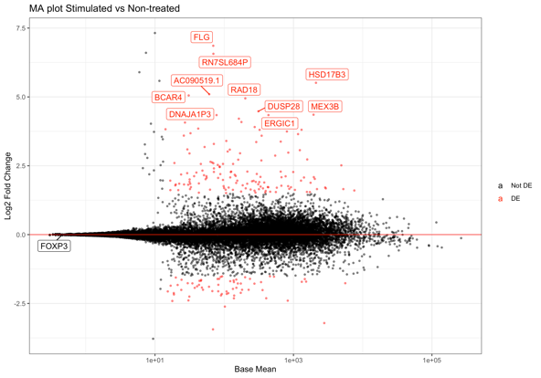
Workflow
Experimental design
Create gene count matrix
Normalization
 | Unt 1 | Unt 1 | Treat 2 | Treat 2
Gene A | 123 | 150 | 143 | 130
Gene B | 18 | 10 | 233 | 209
DESeq
 | Unt 1 | Unt 1 | Treat 2 | Treat 2
Gene A | 13.8 | 14.2 | 12.4 | 14.6
Gene B | 1.9 | 1.25 | 24.1 | 20.9
Untreated
Treated
Sample comparison
GO term and pathway analysis
DE analysis
DESeq
GOrilla,
DAVID,
PANTHER
Distance heatmap and PCA
MA plots, Volcano plots or Heatmaps
Network analysis
Gene-gene correlation analysis
Cytoscape
DGCA

